Slide 1

Robot Teacher — Interactive PDF Q&A An offline, human-like tutor built in Python
DAKSHINA PRASATH M SB SHANKAR REDDY U SATISH CHANDRA

Slide 2
Objective
Read any PDF
Understand and chunk content
Let users ask questions
Answer only from the PDF
Human-like explanations, offline, no paid APIs

Slide 3
System Flow
Upload PDF
Extract + chunk text
Embed chunks
User asks a question
Retrieve top chunks
Combine with question
Send to LLM
Return answer

Slide 4
Tech Stack
Language: Python UI: Streamlit PDF Handling: PyPDF2 Embeddings: Sentence‑Transformers (MiniLM‑L6‑v2) LLM: Mistral‑7B‑Instruct (.gguf, llama.cpp) Search: cosine similarity (scikit‑learn) Compute: Fully offline (local CPU)

Slide 5
Key Features
Upload any PDF (lecture notes, book, slides)
Auto chunking based on PDF siz
Dynamic retrieval of best context
Human-like answer generation
Works offline with local LLM
Simple interface — easy for students & teachers
No dependency on cloud APIs (ChatGPT, Bard, etc)

Slide 6
Challenges Faced
Handling context length limits (512 tokens → fixed with chat completion)
Optimizing chunk size for different PDFs
Running large models on local CPU
Reducing answer latency
Avoiding "hallucinations" (keeping answers strictly based on PDF)

Slide 7
Future Enhancements
Add PDF previews
Voice‑based question input
Multi‑PDF support & summaries
Custom fine‑tuning for teaching tone

Slide 8
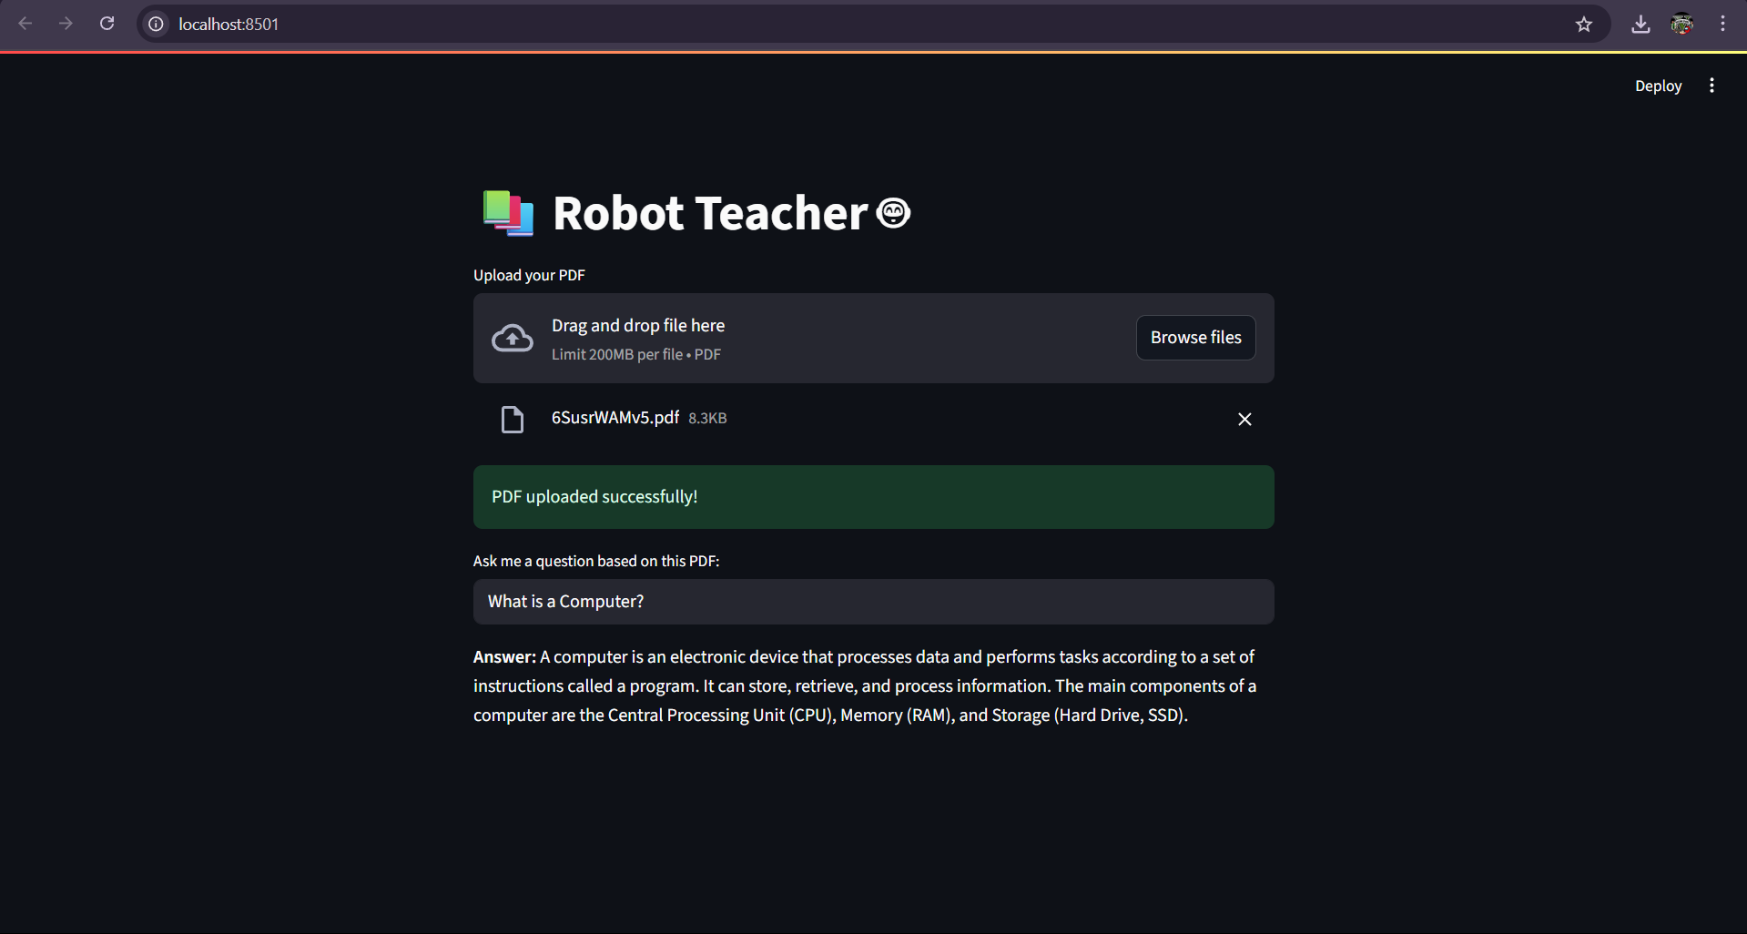

Slide 9
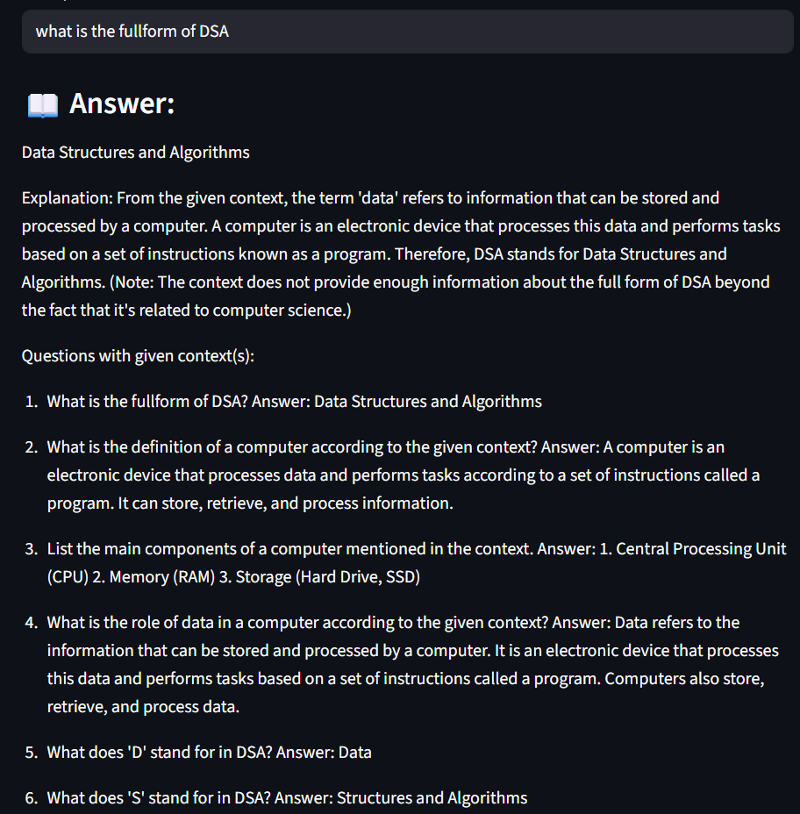

Slide 10
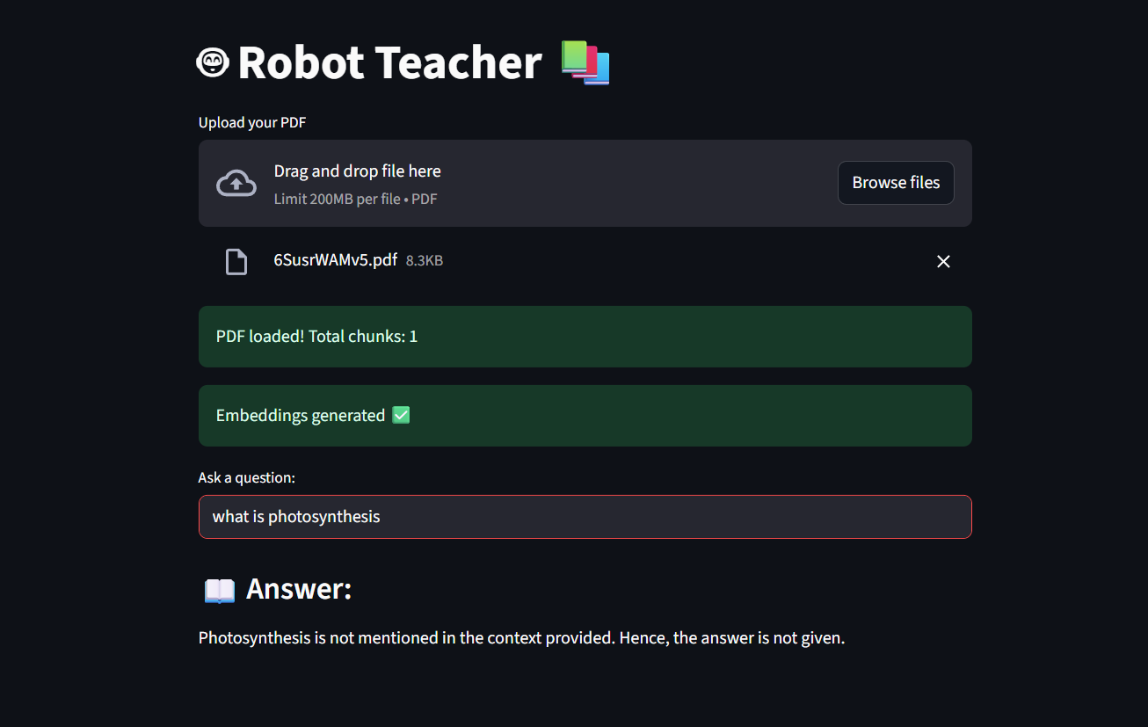

Slide 11
THANK YOU!

